Slide 1
Software Engineering and Architecture
Bloch Builder

Slide 2
Problem
We need to define PersonIdentity objects
Representing
Names, SSN (CPR), phone numbers, gender, date of birth, address, title, …
Moreover, need to define partial knowledge
I.e. ‘Per Christensen’ but we do not know date of birth, phone number, etc.
And potential with complex constraints
Ex. Assign title ‘Mr.’ to male, ‘Miss’ to female, in case no title is assigned
And they are immutable objects
Objects with complex state to be set

Slide 3
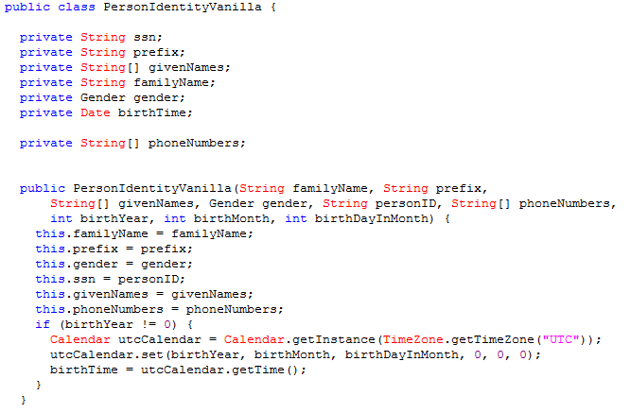
Problem
The solution is well known: Constructor parameters…

Slide 4
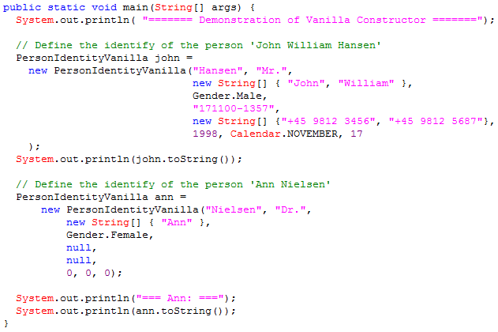
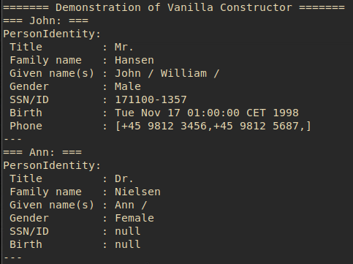
Usage…
Defining John and Ann…
Exercise: Liabilities ???
Notes:
Lots of strings, what if I exchange two of them. (Mathilde birth example! A programmer can annoy thousands of peopl in the blink of an eye).
Weird string arrays. No overview of what goes where. Lots of nulls for incomplete data.

Slide 5
Exercise
An alternative would be
PersonIdentity pi = new PersonIdentity();
pi.setFamilyName(”Hansen”);
pi.addGivenName(”Kaj”);
pi.setGender(Gender.Male);
…
Why is this not an acceptable solution?
Notes:
Trick question: It is because I stated that I wanted an Immutable object; one whose state cannot be changed. Setters allows – well – setting the state.

Slide 6
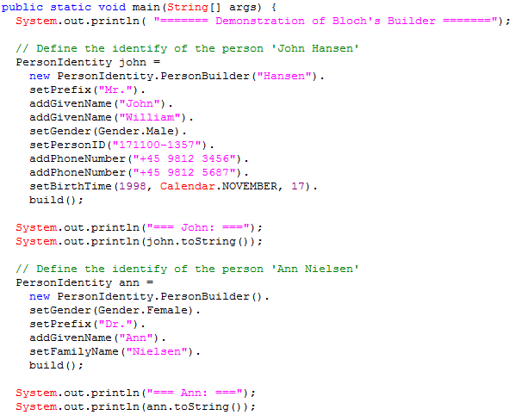
Bloch’s Builder / Effective Java
Alternative
Construct a builder object, using its setter methods, and finally ask it to build the PersonIdentity

Slide 7

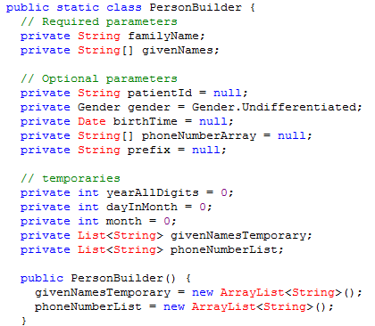
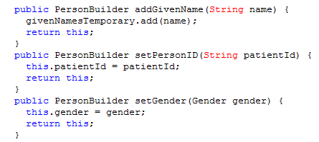
Bloch’s Builder / Effective Java
The internal Builder

Slide 8
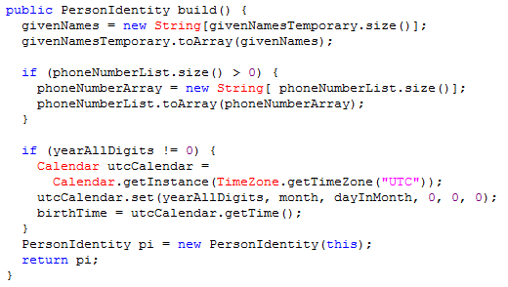
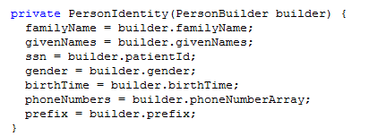
Bloch’s Builder / Effective Java
The build() method
Depends on private constructor

Slide 9
The Two-Phase Process
The algorithm
You create the internal builder object
You set all state, using its setters, in temporary state variables, in the internal builder
You invoke its build()
Which can
Verify constraints between state variables
Set/alter additional state as defined by requirements
Compute the final state space, and…
… that invokes the final object’s constructor
That copies from the builder’s state into its own state variables

Slide 10
3-1-2 ???
Hm…
(2) Favor object composition
Two objects collaborate to produce a single immutable object

Slide 11
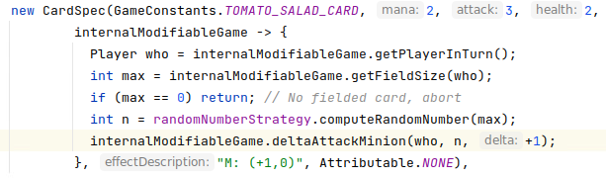
Another Example
EtaStone ‘Effect’s
When a card is played, it executes an ‘effect’
Old ‘direct’ code for EtaStone’s TomatoSalad

Slide 12
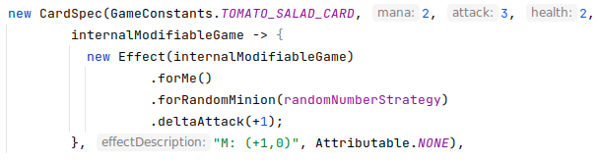
Effect
New code, using a Fluent API

Slide 13
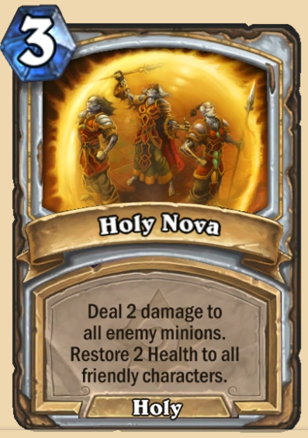
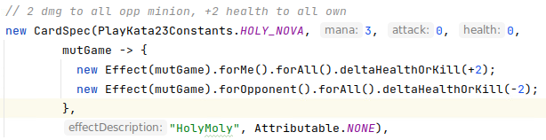
Other Examples
From my SigmaStone
The point
Readable and very short

Slide 14
Analysis
Do not talk to strangers?
Benefits
Improved analyzability of complex object construction (fluent API)
Improved reliability (lower probability of wrong coding)
Improved support for partial object construction
Improved support for constraint checking
Liabilities
Complex coding of the internal builder
Intermediate state objects
Lots of named setters
Private constructor in the outer/final object
Conclusion: Careful evaluate benefit/liabilities

Slide 15
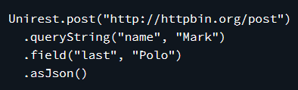

Why do you need to know?
This builder is increasingly seen in open source libraries
Example:
Unirest
asJson() builds the http request and executes it
TestContainers
Build docker containers
Logging frameworks, Mock frameworks, …

Slide 16
Relation to GoF Builder
Bloch states that this pattern is equal to GoF’s Builder pattern
I do not really agree…
The Intent is different. GoF Builder intent: ”… so the same construction process can create different representations”
Bloch’s builder intent is to create single representation but solves faced with many constructor parameters

Slide 17

Reference
Great book ☺

